Slide 1

Validate Configured Subscription YANG-Push Publisher Implementations IETF 123 Hackathon, July 19-20th 2025
NMOP & NETCONF WG

Slide 2

Hackathon Plan, Software and Website
Test Plan
Subscription automation
Discover YANG-Push systems and notifications capabilities and configure periodical and on-change subscriptions with netconf.
Notification integration
Validate subscription state change and push-update and push-change-update notifications against schema with yanglint
Validate draft-ietf-nmop-message-broker-telemetry-message for draft-ietf-nmop-yang-message-broker-integration integration
Development Plan
MVP 1 – Basic Requirements (9)
MVP 2 – Scale and Secure (3)
MVP 3 – Optimizations (2)
Software
YANG-Push Publisher - Cisco IOS XR
YANG-Push Publisher - 6WIND VSR
YANG-Push Publisher - Huawei NE (Router) and MA (OLT)
YANG-Push Receiver – Netgauze
udp-notif dissector - Wireshark
NMOP & NETCONF WG
https://www.network-analytics.org/yp/how-to-deploy.html

Slide 3
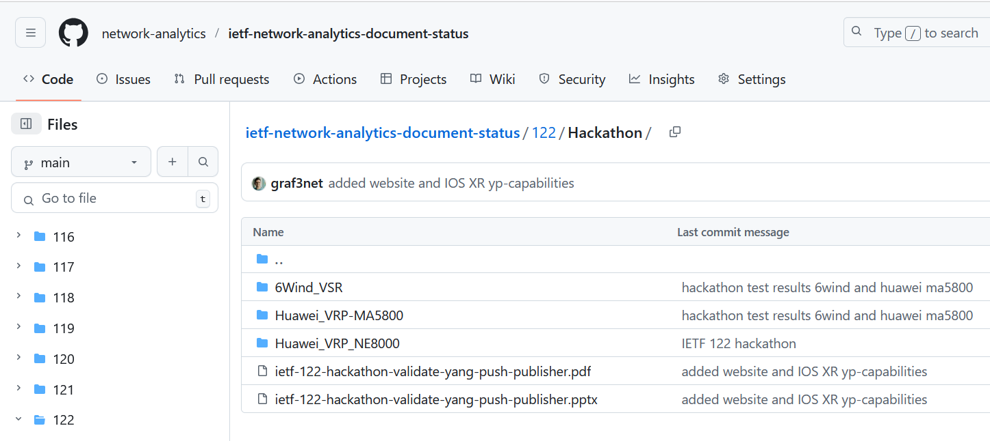
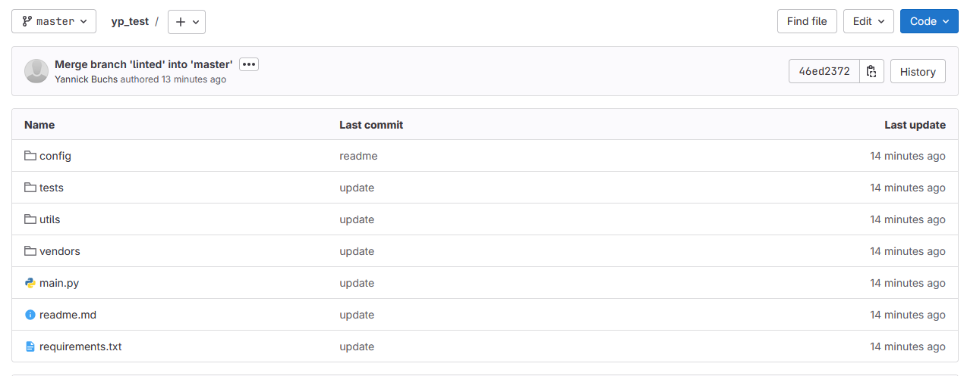
Hackathon – Repositories
Test Result Repository
https://github.com/network-analytics/ietf-network-analytics-document-status/tree/main/123/Hackathon
Contains
Packet capture on the wire
Netconf RPCs and YANG-Push JSON and CBOR encoded messages
NMOP & NETCONF WG
Test Tool Repository
https://github.com/network-analytics/yp_test
Contains
YANG-Push Test Automation Tool
Vendor deviations configuration

Slide 4
An Architecture for YANG-Push to Message Broker Integration draft-ietf-nmop-yang-message-broker-integration draft-ietf-nmop-message-broker-telemetry-message
+------------------------------------------------------------+
| Data Storage |
+------------------------------------------------------------+
^
| (12) Ingest Data
| According to Schema
+------------------------------------------------------------+
| Data Consumer |
+------------------------------------------------------------+
| ^ ^
(10) Get | | | (9) Validate
Schema | | | Serialized Message
| | | Schema on Consumer
| | +--------------------+
| | | Message |
| | | Broker |
| | +--------------------+
| | ^
| | | (8) Serialize
| | (11) Issue | YANG-Push Message
| | Schema | annotated Schema
v | (6) Post | ID on Producer
+--------------------+ Schema +--------------------+
| YANG | <--------------- | Data Collection |
| Schema Registry | ---------------> | YANG-Push Receiver |
+--------------------+ (7) Issue +--------------------+
Schema ID | ^ (3) Receive
| | YANG-Push
(4) Discover | | Subscription
Schema | | Start Message
Dependencies | | ^
and Obtain | | | (5) Publish
Schemas | | | YANG-Push
| | | Message
| | | with
(1) Discover | | | Subscriber
Notification v | | ID
+--------------------+ Capabilities +--------------------+
| Manage YANG-Push | ---------------> | Network Node |
| Subscription | ---------------> | YANG-Push Publisher|
+--------------------+ (2) Subscribe +--------------------+
Subscription to YANG Notifications RFC 8639
Subscription to YANG Notifications for Datastore Updates RFC 8641
UDP-based Transport for Configured Subscriptions draft-ietf-netconf-udp-notif
Subscription to Distributed Notifications draft-ietf-netconf-distributed-notif
Extensible YANG Model for YANG-Push Notifications draft-ietf-netconf-notif-envelope
Support of Versioning in YANG Notifications Subscription draft-ietf-netconf-yang-notifications-versioning
YANG Modules Describing Capabilities for Systems and Datastore Update Notifications RFC 9196
YANG Notification Transport Capabilities draft-ietf-netconf-yp-transport-capabilities
YANG Library RFC 8525
Augmented-by Addition into the IETF-YANG-Library draft-ietf-netconf-yang-library-augmentation
Encoding of Data Modeled with YANG in the CBOR RFC 9254
NMOP & NETCONF WG

Slide 5
YANG-Push Test Setup
NMOP & NETCONF WG

Slide 6
YANG-Push Test Automation Tool – Usage 1
python3 main.py --config config/yp_test_config.yml --vendor cisco_iosxr --help
usage: yp_test [-h] --vendor {6wind,cisco_iosxr,huawei_vrp_ne} -c CONFIG [-u RECEIVER_USERNAME] [-i RECEIVER_INSTANCE_NAME] [--subscriptions] [--all] [--override_timer OVERRIDE_TIMER] [-v] [-vv]
[--tests TESTS [TESTS ...]] [--list-tests]
YANG Push Test Suite (modular, multivendor version)
optional arguments:
-h, --help show this help message and exit
--vendor {6wind,cisco_iosxr,huawei_vrp_ne}
Vendor name (choices: 6wind, cisco_iosxr, huawei_vrp_ne)
-c CONFIG, --config CONFIG
YAML config file
-u RECEIVER_USERNAME, --receiver-username RECEIVER_USERNAME
user used for SSH connection (overrides config file)
-i RECEIVER_INSTANCE_NAME, --receiver-instance-name RECEIVER_INSTANCE_NAME
YANG-Push receiver-instance-name (overrides config file)
--subscriptions
--all
--override_timer OVERRIDE_TIMER
-v, --verbose
-vv, --very_verbose
--tests TESTS [TESTS ...]
Select one or more tests or test sequences to run in order. Use --list-tests to see the choices.
--list-tests List all available tests and sequences, then exit.
enjoy
NMOP & NETCONF WG

Slide 7
YANG-Push Test Automation Tool – Usage 2
python3 main.py --config config/yp_test_config.yml --vendor cisco_iosxr --list-tests
Available tests:
yangpush_delete_subsciptions
yangpush_delete_receivers
netconf_get_discover_yang
netconf_get_ietf_notification_capabilities
netconf_get_ietf_system_version
netconf_get_ietf_yang_library_augmentedby
netconf_get_system_capabilities
netconf_get_yang_library
netconf_get_schema_ietf_notification_transport_capabilities
netconf_get_schema_ietf_udp_notif_transport
netconf_get_schema_ietf_yang_library_augmentedby
netconf_get_schema_ietf_yang_push
netconf_get_schema_ietf_yang_push_revision
netconf_get_schema_ietf_yp_notification
netconf_get_schema_ietf_yp_observation
netconf_get_schema_ietf_yp_transport_capabilities
netconf_get_schema_ietf_system_capabilities_yang
yangpush_add_receiver
yangpush_ietf_interface
yangpush_vendor_interface
netconf_get_schema_ietf_interfaces_yang
yangpush_get_subscriptions
yangpush_post_test_cleanup
Available test sequences:
MVP1
capabilities_sequence
NMOP & NETCONF WG

Slide 8
YANG-Push Test Automation Tool – Usage 3
python3 main.py --config config/yp_test_config.yml --vendor cisco_iosxr --tests netconf_get_discover_yang netconf_get_ietf_system_version
+------------------------------------------------------------------+
| Running tests for vendor: cisco_iosxr and hostname: 203.0.113.91 |
+------------------------------------------------------------------+
...Excempted for brevty...
--------------------------------------------------------------------------------
=== Test Results:
+---------------------------------+----------+------------+---------------------------------------------+
| Test | Status | Duration | Error |
+=================================+==========+============+=============================================+
| netconf_get_discover_yang | PASS | 1.36s | |
+---------------------------------+----------+------------+---------------------------------------------+
| netconf_get_ietf_system_version | FAIL | 0.02s | Received empty response for get-ietf-sys... |
+---------------------------------+----------+------------+---------------------------------------------+
Selected test sequences: []
Results saved in ./results/ipf-zbl1327-r-daisy-91_cisco_iosxr_20250627_201714
Results directory tree:
ipf-zbl1327-r-daisy-91_cisco_iosxr_20250627_201714/
stdout.log
yp_config_backup.xml
get-discover-yang.txt
yp_test.log
NMOP & NETCONF WG

Slide 9
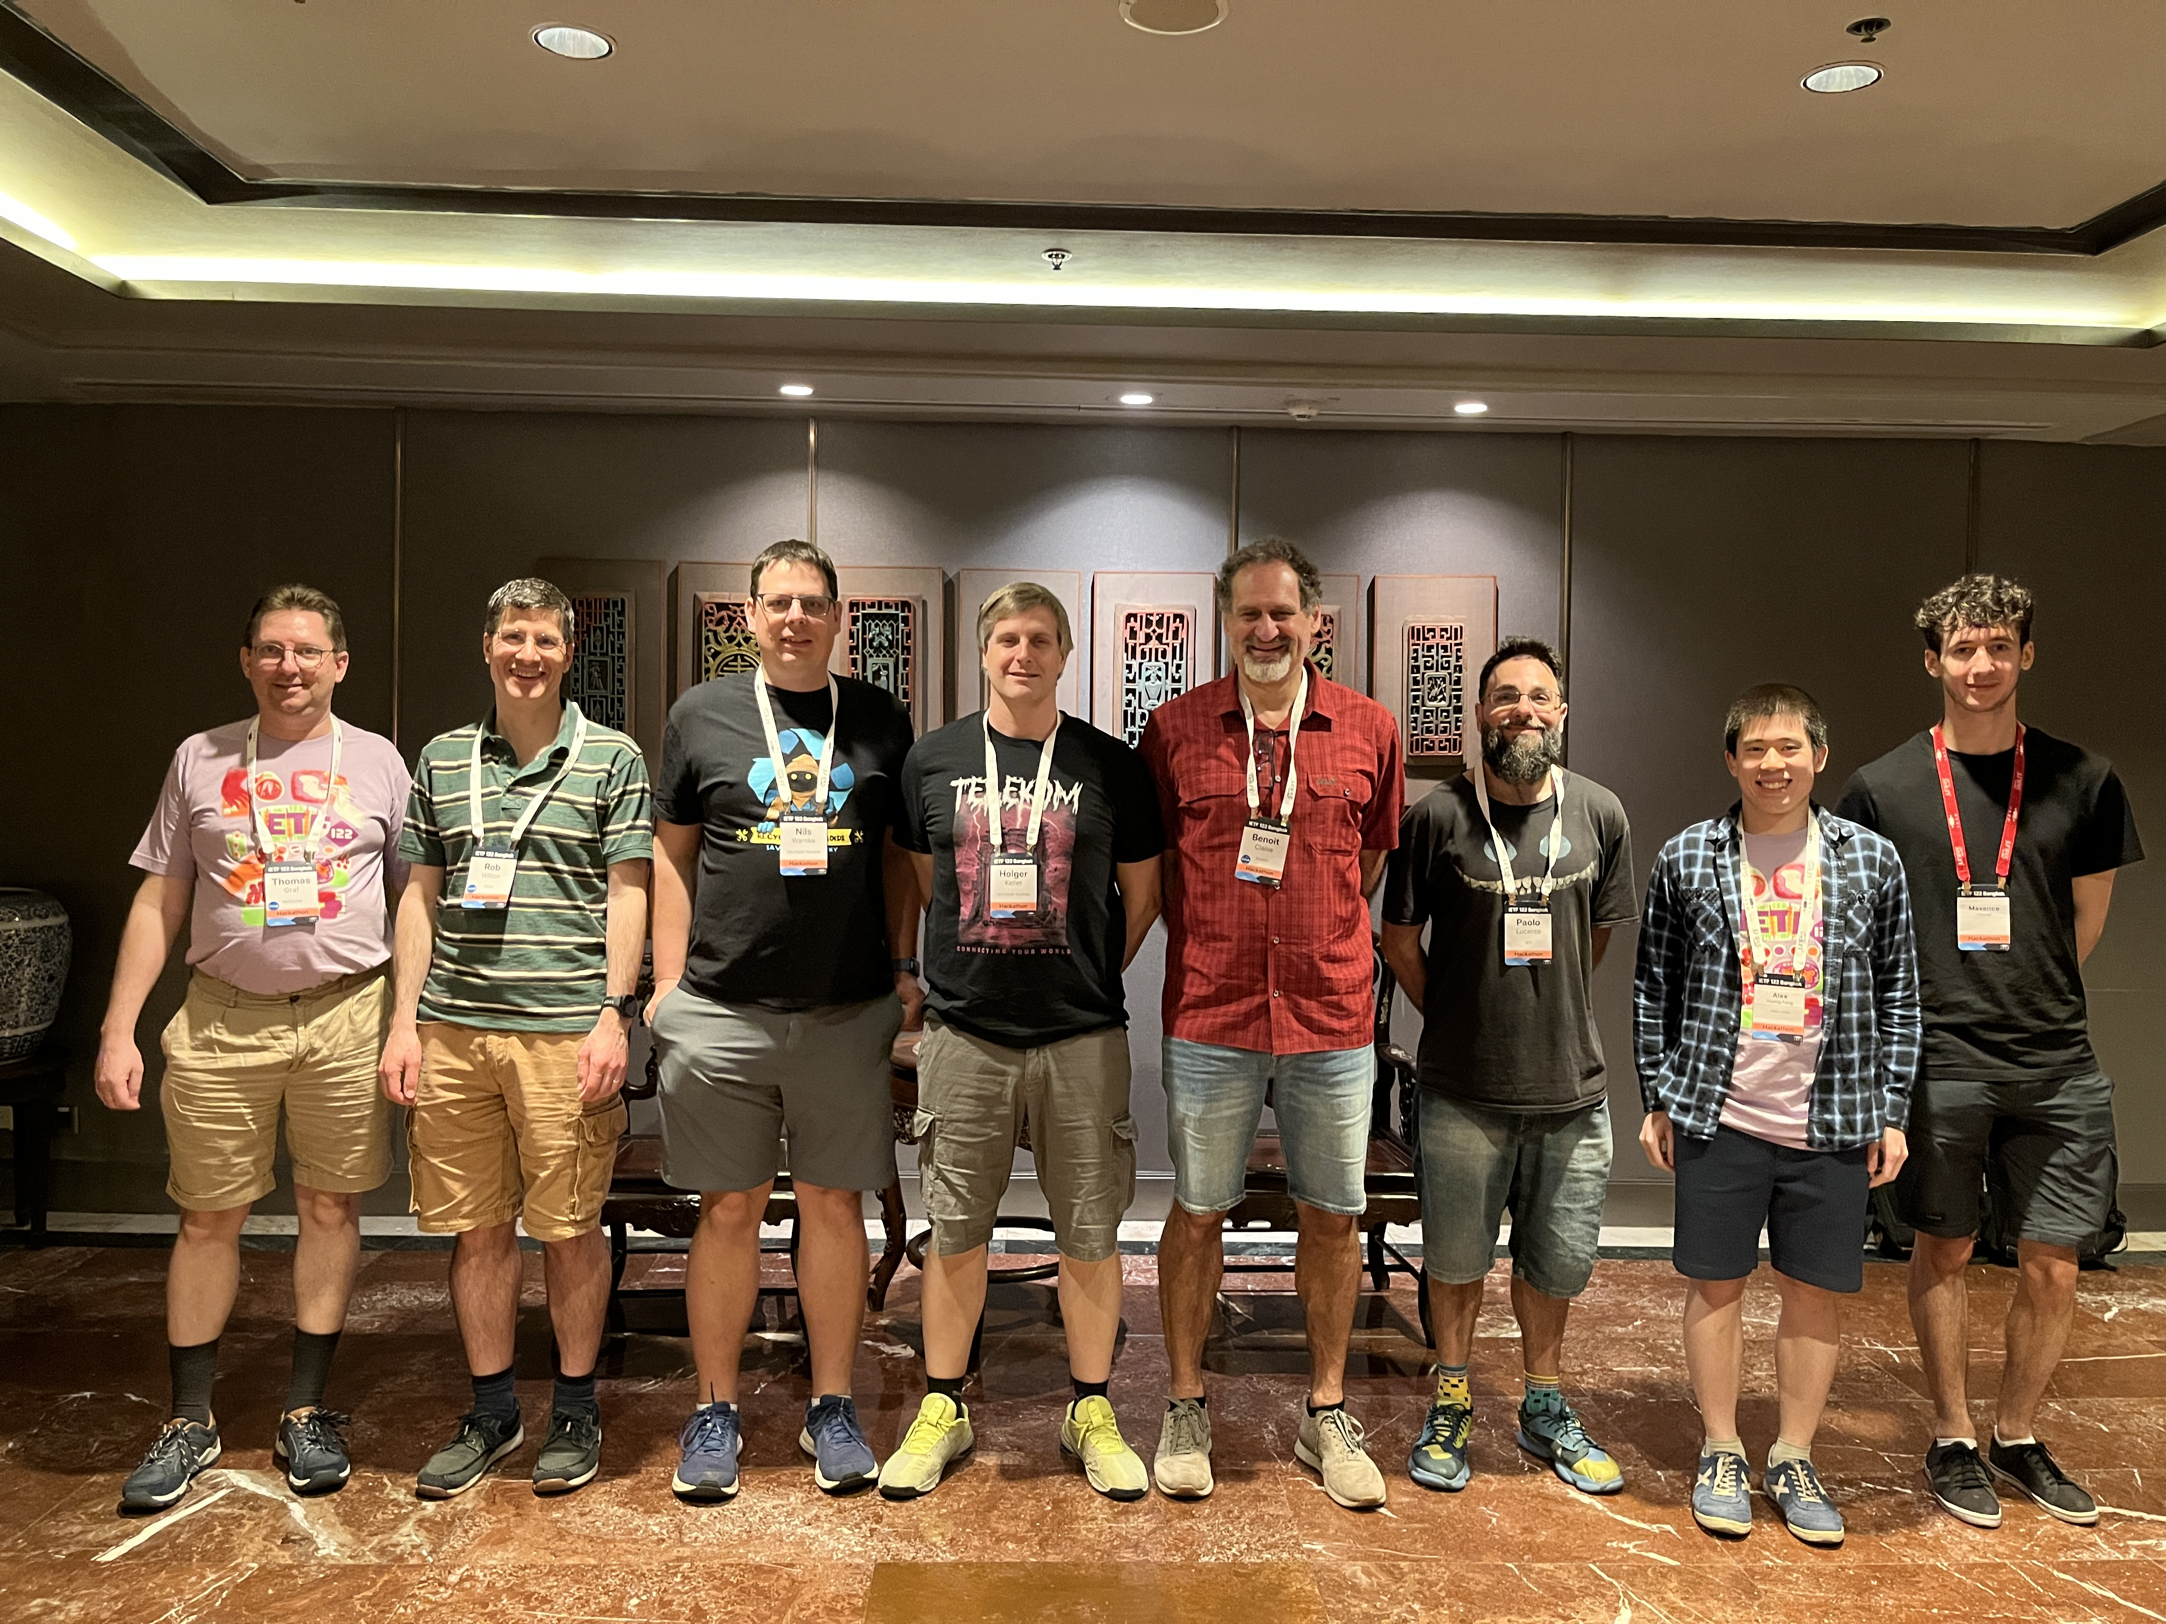
Thanks to…
Rob Wilton – Cisco
Nick Corran – Cisco (remote)
Emma Rankin – Cisco (remote)
Mathew Green – Cisco (remote)
Samuel Gauthier – 6WIND (remote)
Jérémie Leska – 6WIND (remote)
Liu Bin – Huawei (remote)
Benoit Claise – Huawei
Zhuoyao Lin – Huawei (remote)
Jiale Li – Huawei (remote)
Jian Ping– Huawei (remote)
Xiao Chen– Huawei (remote)
Paolo Lucente – Pmacct
Holger Keller – DT
Nils Warnke - DT
Alex Huang-Feng – INSA Lyon
Yannick Buchs – Swisscom (remote)
Thomas Graf – Swisscom
NMOP & NETCONF WG

Slide 10

State of the Union From data mess to data mesh
Today, subscribing to a YANG datastore, publishing a YANG modeled notifications message from the network and viewing the data in a time series database, manual labor is needed to perform data transformation to make a message broker and its data processing components with YANG notifications interoperable.

